Slide 1


Slide 2








WELCOME TO GLOBAL LEADERSHIP SUMMIT
We’re so glad you are here!
LEAD WHERE YOU
ARE.

Slide 3

GOT QUESTION?
NEED HELP?
OUR TEAM IS
HERE TO SERVE!
?

Slide 4
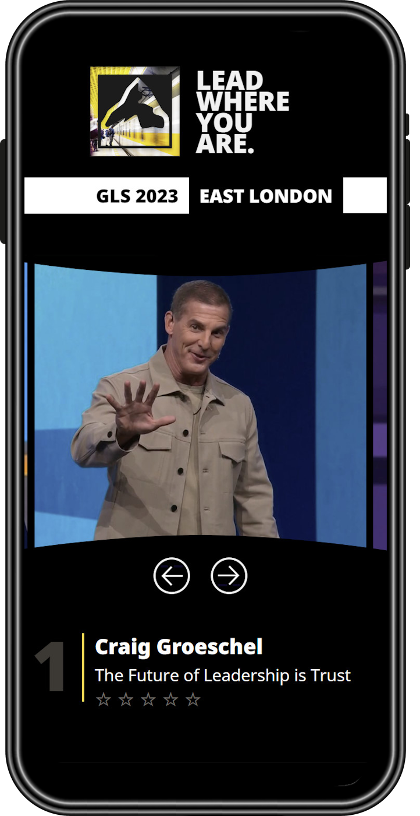

SECOND SCREEN
Session notes and links
7 day replay access
globalleadership.uk/second-screen

Slide 5

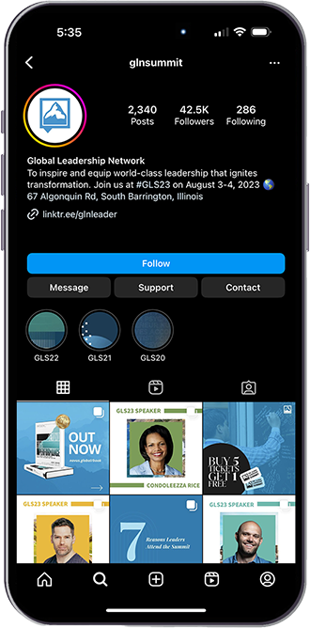
ENGAGE WITH US!
FOLLOW AND
TAG #GLS23 ON
SOCIAL MEDIA
@GLNUKI #GLSummitUKI

Slide 6


CONNECT WITH
OTHER WOMEN TO GROW AND ENCOURAGE ONE ANOTHER IN LEADERSHIP.
LEARN MORE AT
GLOBALLEADERSHIP.ORG/WOMENLEADERS

Slide 7


HOW WAS GLS23?
PLEASE LET US KNOW HOW WE CAN CONTINUE TO IMPROVE.
HELP US GET BETTER.

Slide 8

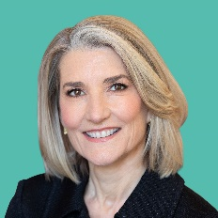
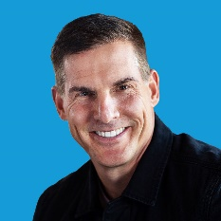
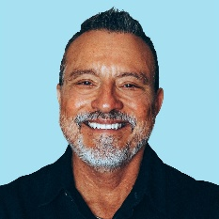
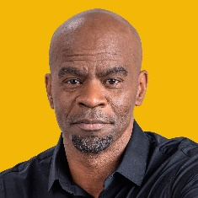
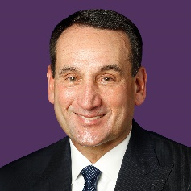
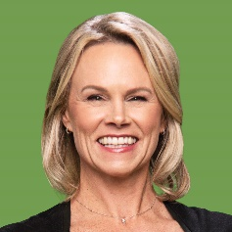
JOIN US
FOR #GLS24
AMY EDMONDSON
Professor of Leadership
and Management,
Harvard Business School
CRAIG GROESCHEL Founding and Senior Pastor, Life.Church,
Best-selling Author
ERWIN MCMANUS
Founder, McManus Masterminds and the Art of Communication
MICHAEL JR.
Comedic Thought Leader
MIKE KRZYZEWSKI
Former American College Basketball Coach
MOLLY FLETCHER
Motivational Speaker and Former Sports Agent
www.globalleadership.uk

Slide 9
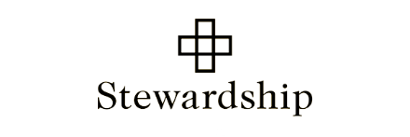





STRATEGIC PARTNERSHIPS
AND COLLABORATORS
Here are some of the organisations who are journeying with us...

Slide 10


Slide 11


Slide 12


Slide 13


