Slide 1
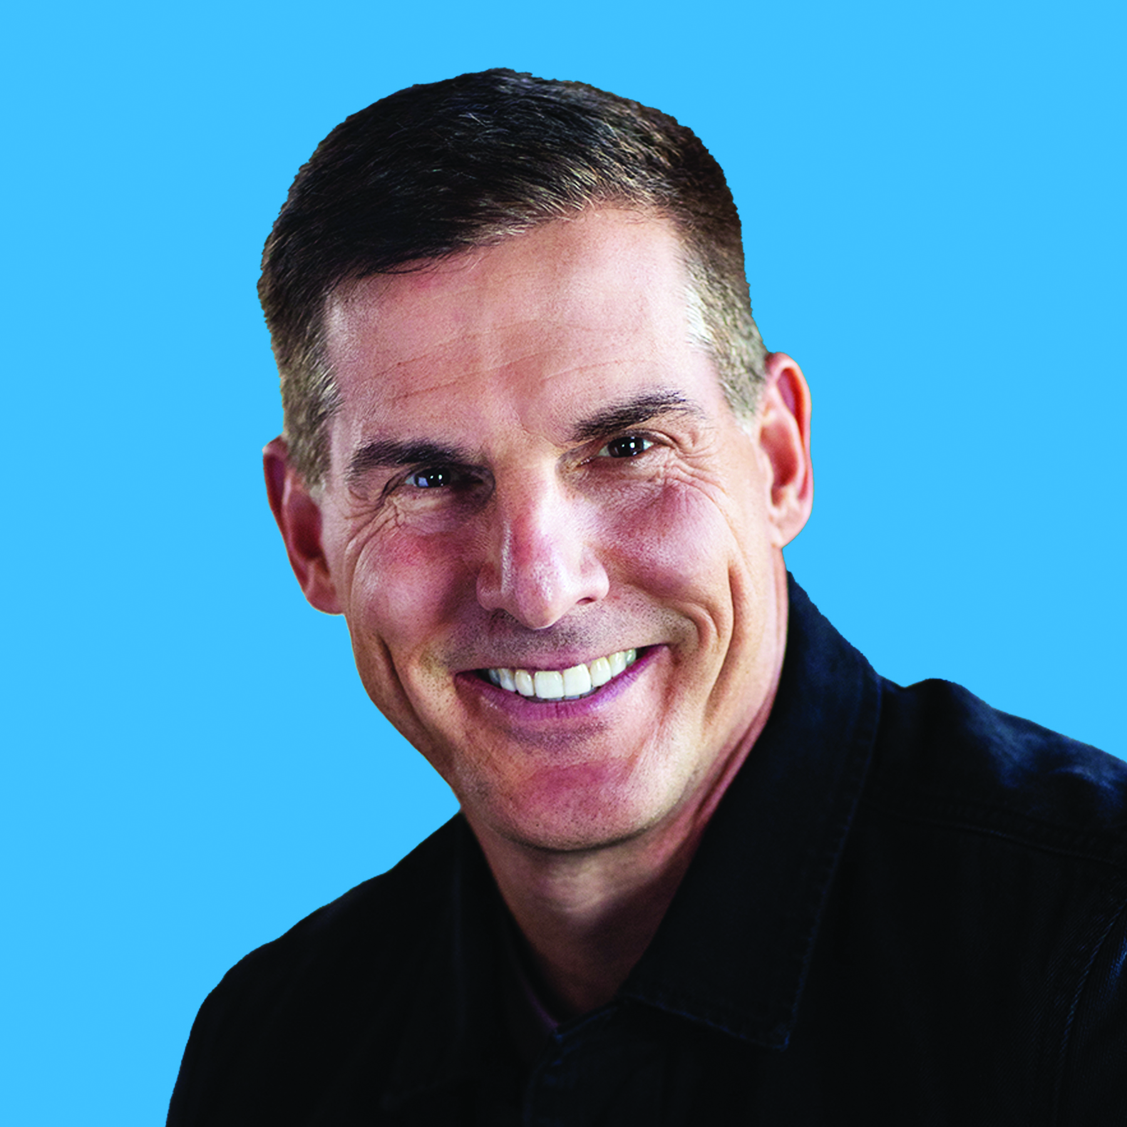
CRAIG
GROESCHEL
The Future of Leadership
IS TRUST

Slide 2
CRAIG GROESCHEL
THE FUTURE OF LEADERSHIP IS TRUST
1. Consider the last few months of your leadership. How do you assess the three factors of trust presented by Craig with your team?

Slide 3
CRAIG GROESCHEL
THE FUTURE OF LEADERSHIP IS TRUST
TRANSPARENCY
0
5
10
EMPATHY
0
5
10
CONSISTENCY
0
5
10

Slide 4
CRAIG GROESCHEL
THE FUTURE OF LEADERSHIP IS TRUST
2. Based on your answers, how do you perceive your team’s trust in you?

Slide 5
CRAIG GROESCHEL
THE FUTURE OF LEADERSHIP IS TRUST
3. Which of the three trust factors do you consider crucial to develop at this time?

Slide 6
CRAIG GROESCHEL
THE FUTURE OF LEADERSHIP IS TRUST
4. What will you do to develop the selected factor? (Think of one or two practical steps)

Slide 7
CRAIG GROESCHEL
THE FUTURE OF LEADERSHIP IS TRUST
TAKING ACTION
What action will you undertake in the next seven days to initiate the cultivation of the trust factor that you identified?

Slide 8
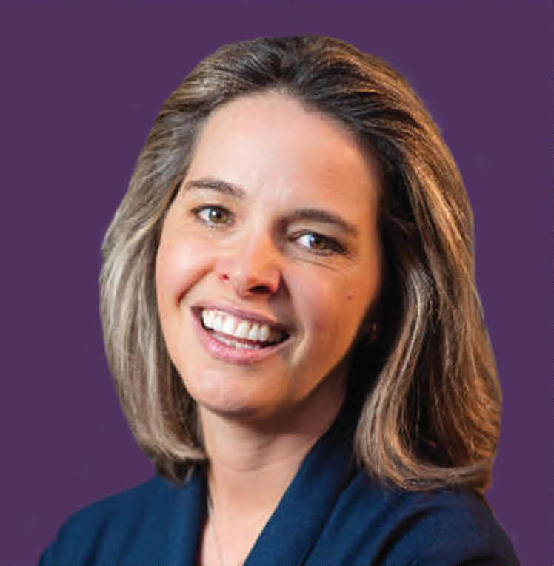
ERIN
MEYER
Fostering a Culture
OF REINVENTION

Slide 9
ERIN MEYER
FOSTERING A CULTURE OF REINVENTION
1. How has the current level of control within your organization impacted the performance of its teams?

Slide 10
ERIN MEYER
FOSTERING A CULTURE OF REINVENTION
2. How do the leaders within your organization handle the presence of average and below-average individuals in their teams? How does this impact high-performing individuals? Furthermore, how does it influence the overall outcomes of the organization?

Slide 11
ERIN MEYER
FOSTERING A CULTURE OF REINVENTION
3. How can you and your group influence the cultural change within your organization aiming to reduce control, increase trust, and consequently enhance people’s performance?

Slide 12
ERIN MEYER
FOSTERING A CULTURE OF REINVENTION
4. What controls or practices are you, as a leader, prepared to relinquish in order to increase trust in your team, enhance its talent density, and elevate its performance?

Slide 13
ERIN MEYER
FOSTERING A CULTURE OF REINVENTION
TAKING ACTION
What initial steps do you plan to take?

Slide 14
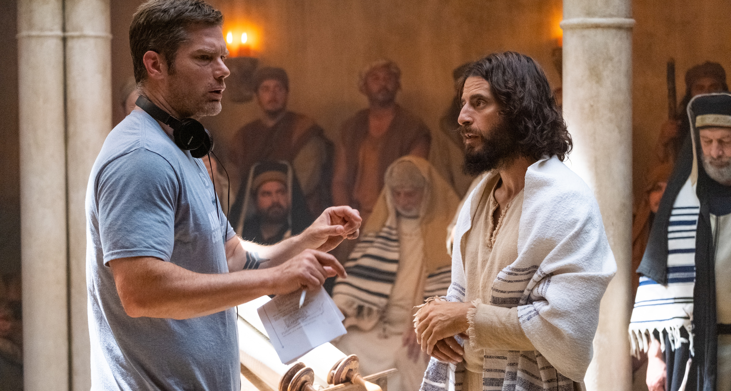
DALLAS
JENKINS
Leading
THE CHOSEN

Slide 15
DALLAS JENKINS
LEADING THE CHOSEN
1. Which principle from Jenkins’ talk grabbed your attention?

Slide 16
DALLAS JENKINS
LEADING THE CHOSEN
Understanding your role and God’s role
Dealing with criticism
As a leader, protecting people and the business
Knowing how to connect with different individuals
Prioritizing service over results
Striving for maximum time efficiency
Communicating effectively
Other_______________________________________

Slide 17
DALLAS JENKINS
LEADING THE CHOSEN
2. How does this principle apply to your context?

Slide 18
DALLAS JENKINS
LEADING THE CHOSEN
3. How do you plan to integrate this principle into both your personal life and leadership?

Slide 19
DALLAS JENKINS
LEADING THE CHOSEN
4. What initial step will you take? When do you intend to take it?

Slide 20
DALLAS JENKINS
LEADING THE CHOSEN
TAKING ACTION
What key lesson from this talk do you consider vital to apply in your daily leadership?

Slide 21
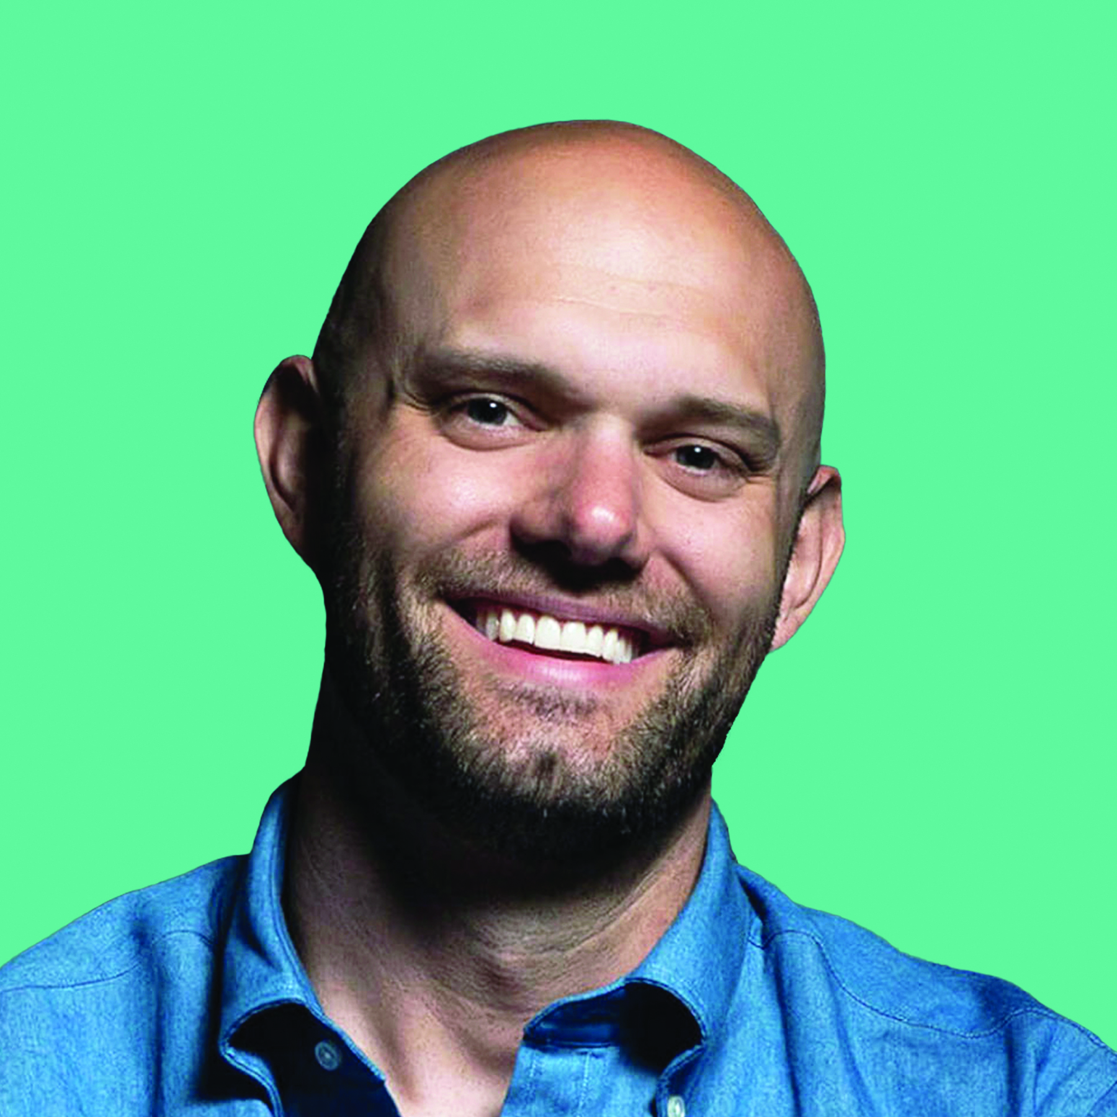
JAMES
CLEAR
Harnessing the Power
OF ATOMIC HABITS

Slide 22
JAMES CLEAR
HARNESSING THE POWER OF ATOMIC HABITS
1. Who would you like to become in one year? Think in terms of identity, the person you aim to be. (e.g. an empathetic leader, a people specialist, a connected parent, a marathon runner, etc.)

Slide 23
JAMES CLEAR
HARNESSING THE POWER OF ATOMIC HABITS
2. What are the habits that this “future you” exhibit? What consistent actions define his/her character?

Slide 24
JAMES CLEAR
HARNESSING THE POWER OF ATOMIC HABITS
3. What current habits are steering you away from who you aim to become in the future and therefore need to break?

Slide 25
JAMES CLEAR
HARNESSING THE POWER OF ATOMIC HABITS
4. Choose one key habit that you need to develop, starting today, to become the person you envision.
Key Habit: _____________________________________________

Slide 26
JAMES CLEAR
HARNESSING THE POWER OF ATOMIC HABITS
5. How will you...
 | CHARACTERISTIC | ACTION
Cue | Is it obvious?
Craving | Is it attractive?
Response | Is it easy?
Reward | Is it satisfying?

Slide 27
JAMES CLEAR
HARNESSING THE POWER OF ATOMIC HABITS
TAKING ACTION
What will you start doing in the next seven days to initiate 1% daily growth?

Slide 28
RYAN
LEAK
Leveling up: Three questions for
NEXT LEVEL LEADERS

Slide 29
RYAN LEAK
LEVELING UP: THREE QUESTIONS FOR NEXT LEVEL LEADERS
Answer: what is your definition of success?
As a leader?
As a follower?
As a parent?
As a __________________ (an important role in your life)?

Slide 30
RYAN LEAK
LEVELING UP: THREE QUESTIONS FOR NEXT LEVEL LEADERS
2. Considering the roles above, how do you think it feels to interact with the other side of you?
As someome following you:
As someome leading you:
As your son/daughter:
As a __________________ (an important role in your life)?

Slide 31
RYAN LEAK
LEVELING UP: THREE QUESTIONS FOR NEXT LEVEL LEADERS
3. Compare your answers between questions 1 and 2. Is there alignment? What requires improvement? What insight do you gain from this?

Slide 32
RYAN LEAK
LEVELING UP: THREE QUESTIONS FOR NEXT LEVEL LEADERS
4. What actions will you take regarding these insights?

Slide 33
RYAN LEAK
LEVELING UP: THREE QUESTIONS FOR NEXT LEVEL LEADERS
TAKING ACTION
What will be your first step towards the next level of leadership?

Slide 34
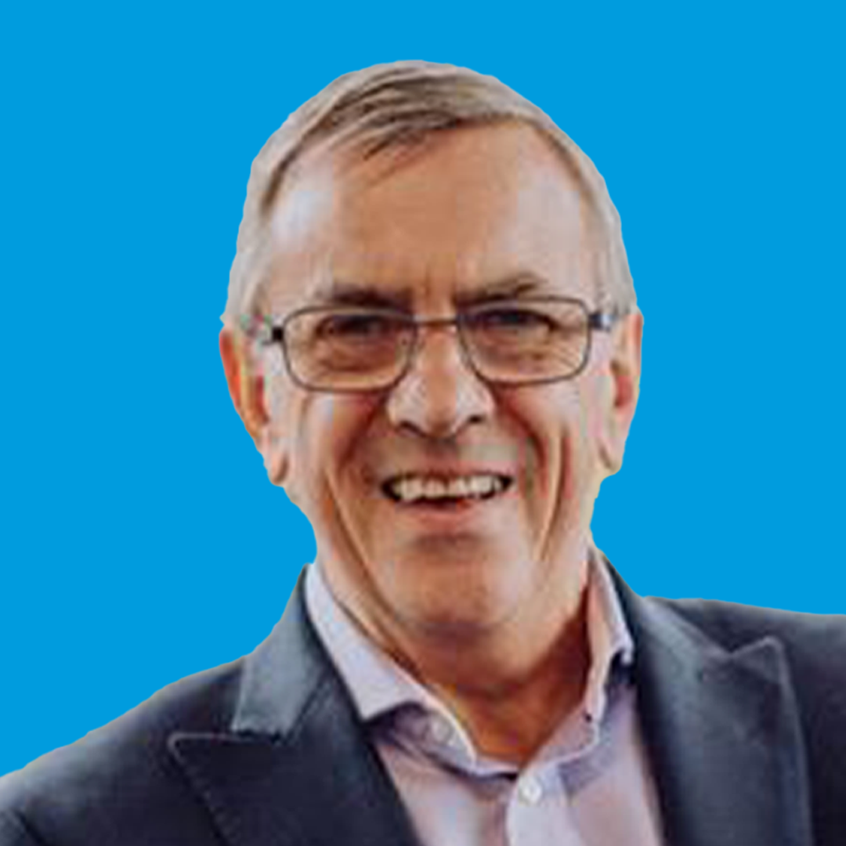
ROB
PARSONS
BEYOND COMMUNICATION
How to really connect with an audience

Slide 35
ROB PARSONS
BEYOND COMMUNICATION : HOW TO REALLY CONNECT WITH AN AUDIENCE
TAKING ACTION
What will be your next step to becoming a better communicator?

Slide 36
ROB PARSONS
BEYOND COMMUNICATION : HOW TO REALLY CONNECT WITH AN AUDIENCE
1. What is the right balance between keeping eye
contact and the use of notes?

Slide 37
ROB PARSONS
BEYOND COMMUNICATION : HOW TO REALLY CONNECT WITH AN AUDIENCE
2. How can we find our own stories and develop them?

Slide 38
ROB PARSONS
BEYOND COMMUNICATION : HOW TO REALLY CONNECT WITH AN AUDIENCE
3. What does it mean in my context to be a ‘keeper of the atmosphere’?

Slide 39
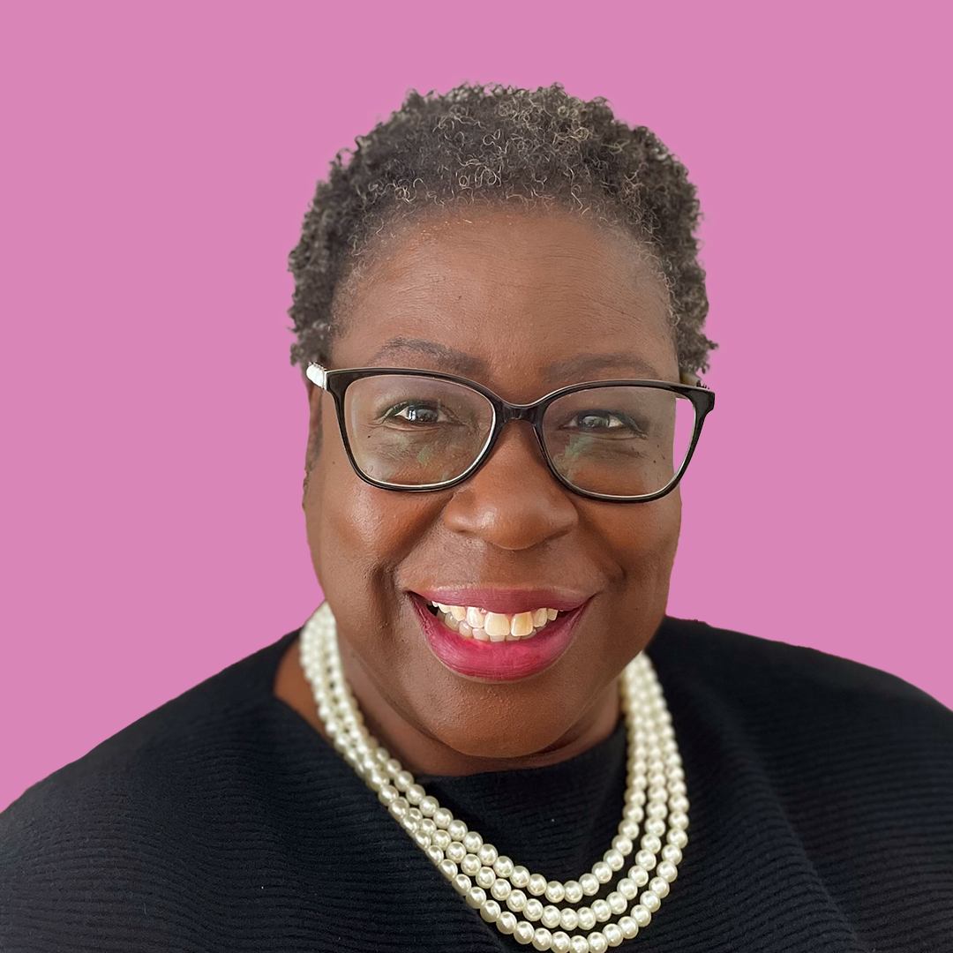
OLIVIA
AMARTEY
Courageous Leadership
LESSONS LEARNED IN A CRUCIBLE

Slide 40
OLIVIA AMARTEY
COURAGEOUS LEADERSHIP : LESSONS LEARNED IN THE CRUCIBLE
1. Drawing upon your own experience, what would be YOUR definition of a courageous leader/ courageous leadership?

Slide 41
OLIVIA AMARTEY
COURAGEOUS LEADERSHIP : LESSONS LEARNED IN THE CRUCIBLE
2. You may be familiar with the popular saying “fake it till you make it”. Can one fake courageous leadership?

Slide 42
OLIVIA AMARTEY
COURAGEOUS LEADERSHIP : LESSONS LEARNED IN THE CRUCIBLE
3. Reviewing your leadership over the last 12 months and drawing upon the leadership challenges you have faced, give an example where you have led courageously? What did you learn about yourself and/or the people you led, in the process?

Slide 43
OLIVIA AMARTEY
COURAGEOUS LEADERSHIP : LESSONS LEARNED IN THE CRUCIBLE
TAKING ACTION

